Slide 1


Shallion Support
Where Compassion Peaks and Support Prevails

Slide 2




The Problem
Up to 90% experience debilitating fatigue impacting daily life
1 in 20 people in the UK live with ME/CFS, Fibromyalgia, or Long COVID
Isolation and mental‑health challenges worsen outcomes
Existing support is medical‑focused, costly, or generic

Slide 3
ME/CFS
Fibromyalgia
Long Covid
Inverness
Lossiemouth
Scotland - Prevalence
Moray
Cumbernauld
Insch (Aberdeenshire)
Aberdeen
Glasgow
Tayside/Perth/Angus
Cathcart (Glasgow)
Montrose
Paisley
St Andrews
Inverclyde
Glenrothes (Fife)
Ardrossan (North Ayrshire)
Coaltown of Wemyss (Fife)
Edinburgh & Lothians
Irvine
West Lothian
Kilmarnock
Falkirk
Stranraer
Grangemouth
Wigtown
Newarthill (North Lanarkshire)

Slide 4
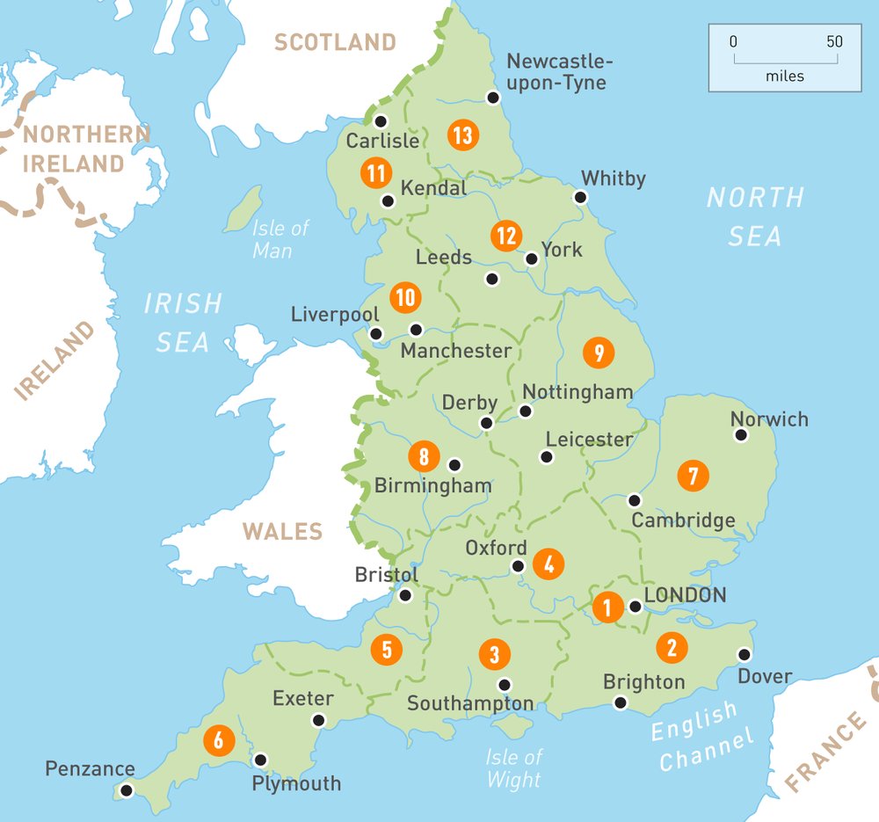
England - Prevalence
Long COVID
Hertfordshire (shared with ME/CFS group)
Online/National (e.g., Long Covid Support charity, Asthma + Lung UK, Covid Aid, Long Covid SOS, Long Covid Kids)
Fibromyalgia
Christchurch (Dorset)
London/Ealing
Redbridge (Greater London)
Dulwich (South London)
Morden (South London)
Tring (Hertfordshire)
Milton Keynes
Medway (Kent)
South-Central England (general area)
South-East England (general area)
Greater London
Midlands (general area)
ME/CFS
Cambridge
Norfolk & Waveney
Dorset
Gloucestershire
West Cornwall
Chiltern (Buckinghamshire/ Oxfordshire area)
Surrey
Sussex & Kent
Richmond & Kingston (Greater London)
South East London
West London
Hertfordshire
Keynsham (Bristol area)

Slide 5






Our Visionary Solution
1
2
3
4
Bespoke, non‑medical home‑support service
Specialised in M.E., Lupus, Fibromyalgia, PTSD & related conditions
Volunteer‑powered model reducing isolation & building community. Expansion to Hiring.
Hybrid paid + free services under social‑enterprise mission

Slide 6





How It Works
AI‑assisted matching with trained volunteers
Referral or self‑sign‑up via web/app
Continuous feedback loop to refine care
01
03
05
02
04
Free needs assessment & tailored support plan
In‑home or virtual assistance (meal prep, housekeeping, IT help, companionship)

Slide 7

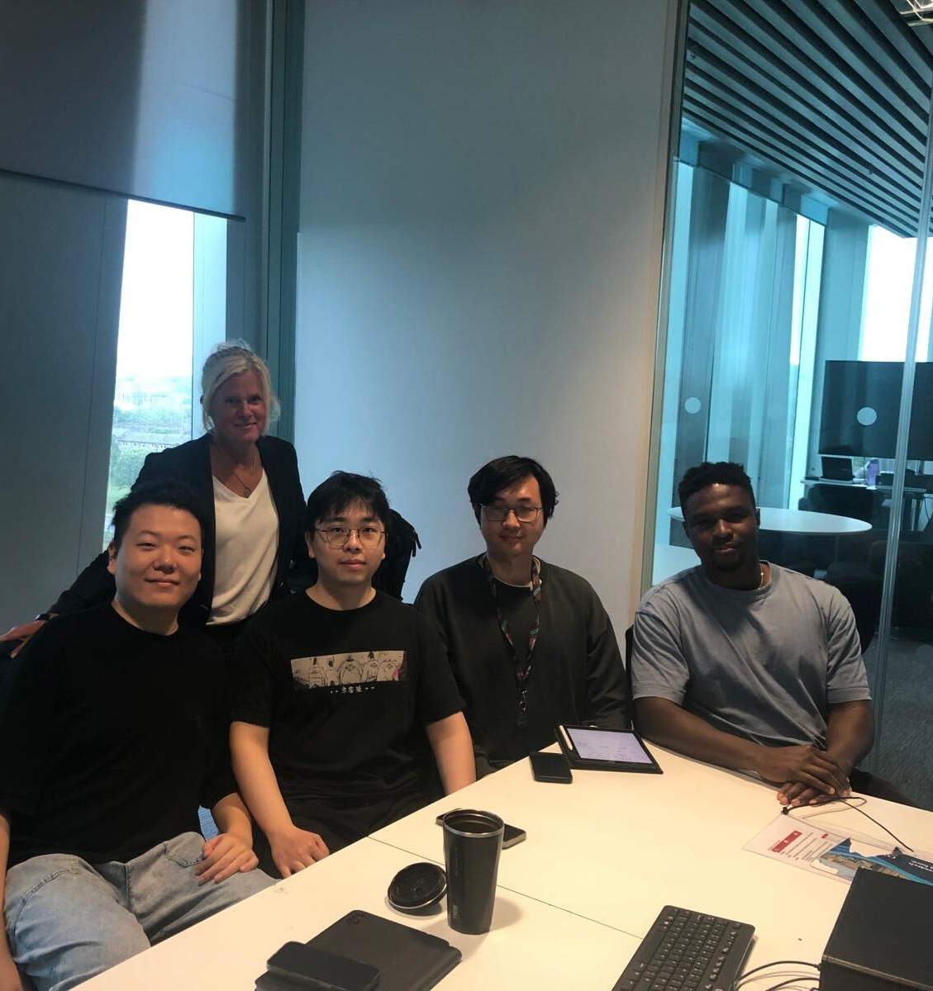




Technology & Partnerships
Collaboration with University of Aberdeen computer‑science department
Matching platform & mobile app launching August 2025
Data‑driven volunteer‑client matching and scheduling
Online shop for branded merchandise & nutrition products built by MSc students
7

Slide 8





4.6 million UK residents receive disability benefits for long‑term conditions
£10 bn+ annual UK home‑care spend and rising with ageing population
Shallion bridges the gap between clinical care and daily‑living support
Dual revenue: service fees, merchandise & nutrition sales, grants & sponsorships
Market Opportunity & Social Impact
8

Slide 9





Traction & Roadmap
Q3 2025
app launch, expansion to Greater Glasgow & Edinburgh
2024‑25 pilot
in Aberdeen:
25 clients, 40 active volunteers
95 % client‑satisfaction; 80 % report reduced isolation
2026
Scotland‑wide coverage & 1 000+ volunteer hours/month
2026
Entire UK expansion

Slide 10




Competitive Landscape
Traditional home‑care agencies – medical
& costly
Volunteer bureau – limited structure
& training
Gig platforms – transactional, short‑term focus
Shallion – specialised, community‑driven, tech‑enabled hybrid model

Slide 11






Business Model & Sustainability
Merchandise & nutritious meal‑kit sales
Government & NHS referrals with funded care packages
Grants, corporate sponsorships, community fundraising
Sliding‑scale service fees for private clients
Target 45 % gross margin on paid services by 2027

Slide 12







Team & Contact
Founders: lived experience + social‑
enterprise leadership
Clinical advisors: Team of Nutritionists specializing in fatigue management
Technology lead: MSc Computer‑Science cohort, University of Aberdeen
Design & marketing: local creative‑
industry volunteers
Contact
hello@shallion.co.uk
www.shallion.co.uk

Slide 13

Our Story
Contact

Slide 14
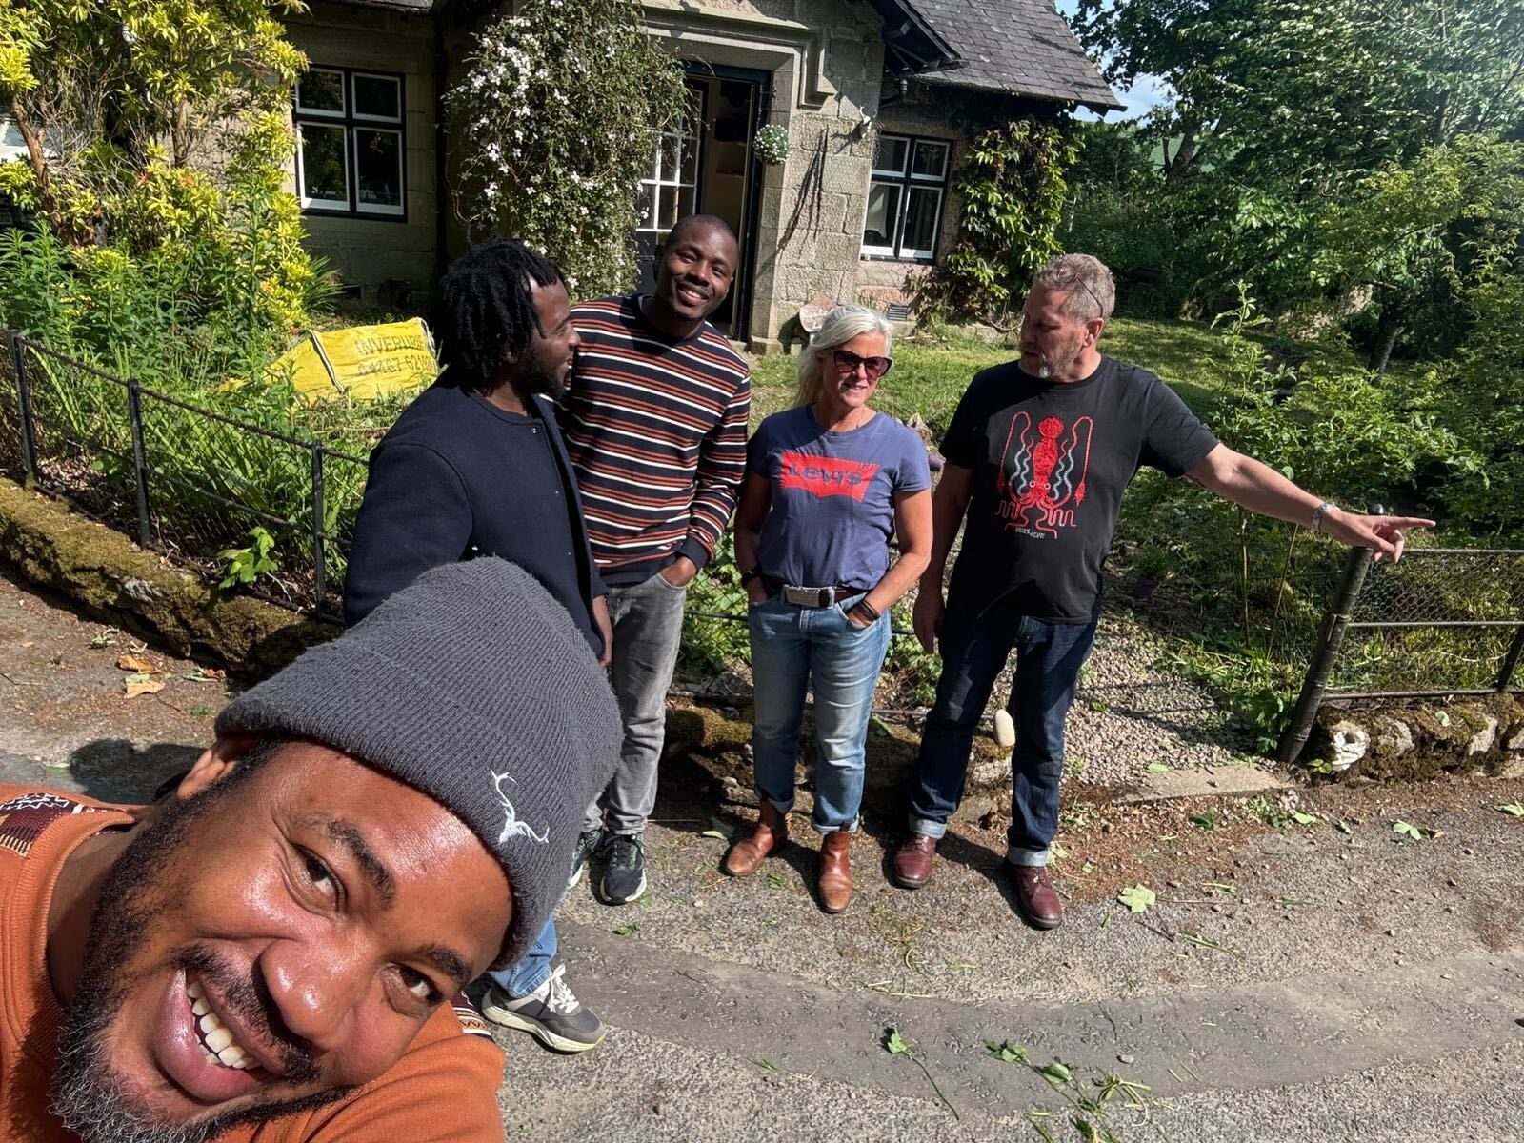
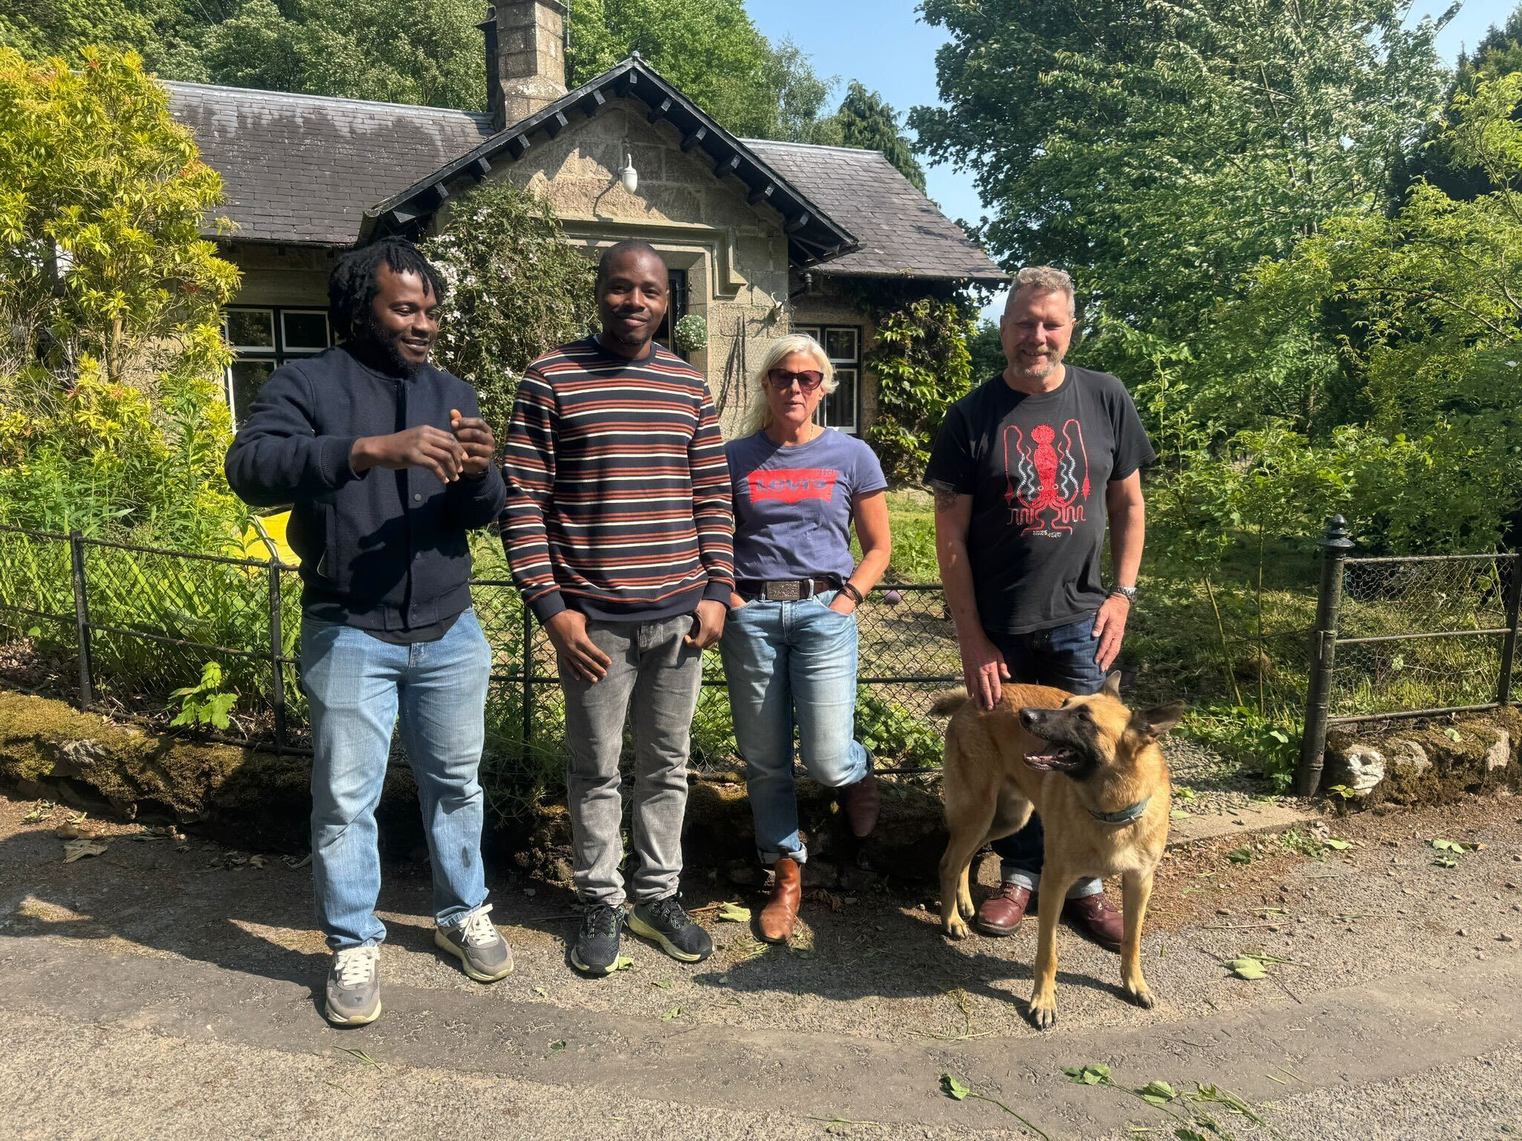
Some of the Team…

Slide 15
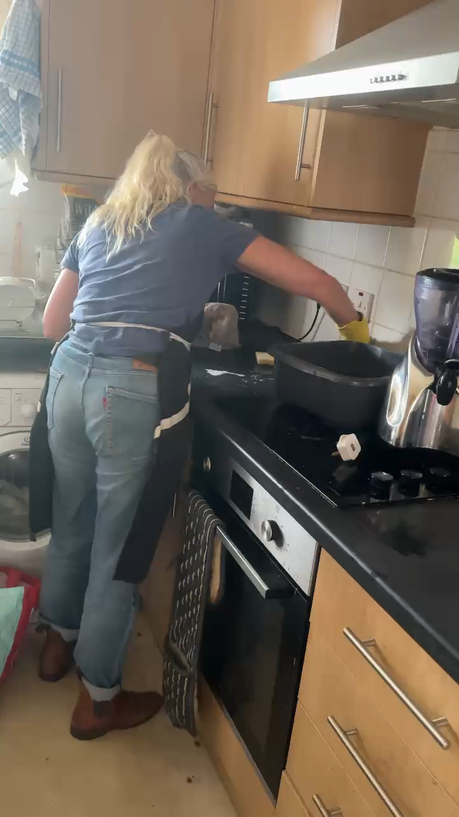
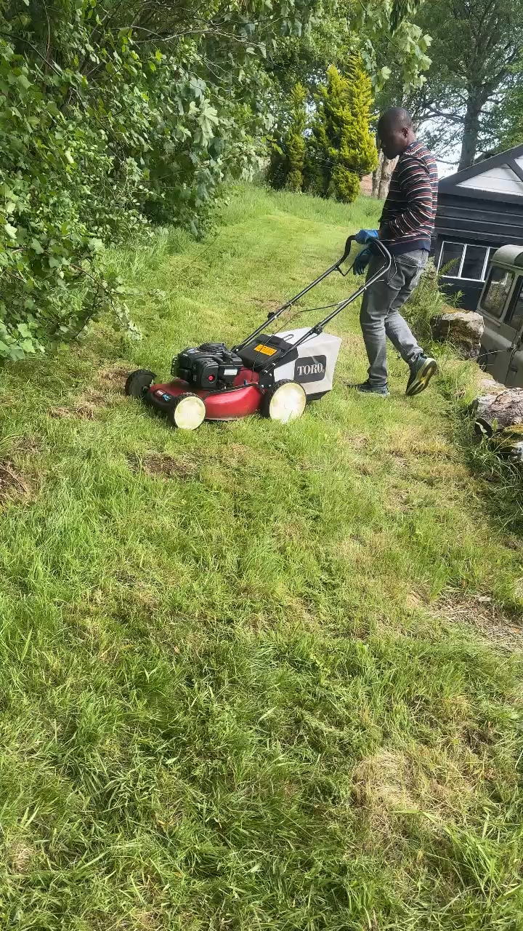
The Team at Work!

Slide 16

20% of anything that anyone buys will go into social enterprise fund to support those to get a free service
16

Slide 17
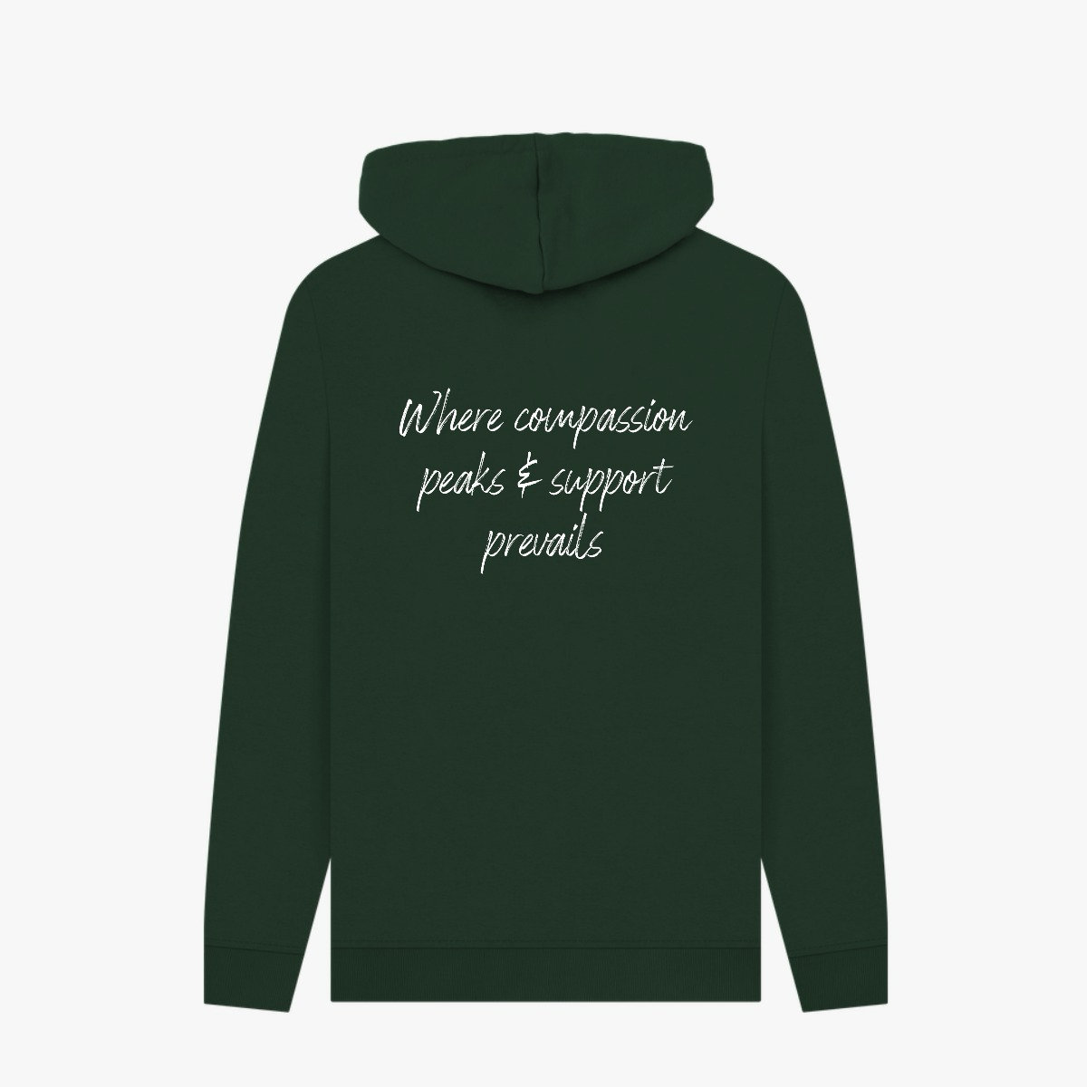





Merchandise
20% of ANY merchandise that is purchased will go into social enterprise fund to support those to get a free service

Slide 18


Thank You
Join us in empowering lives touched by chronic illnesses.

Slide 19
Shallion Support – Project Overview
Background: 1 in 20 people in the UK live with ME/CFS, Fibromyalgia, or Long COVID.
Aims: Develop a bespoke, non-medical home-support service to address daily-living challenges, reduce isolation, and improve quality of life.
Context: Existing supports are medical-focused, costly, or generic, leading to unmet needs.

Slide 20
Methods Used
• Needs assessment of target population.
• Development of referral/self-sign-up process.
• Collaboration with University of Aberdeen for tech platform.
• AI-assisted volunteer-client matching.
• Pilot program in Aberdeen with continuous feedback loops.

Slide 21
Results / Products Developed
• Pilot program with 25 clients and 40 active volunteers.
• 95% client satisfaction; 80% reported reduced isolation.
• Mobile matching platform (launching Aug 2025).
• Online shop for merchandise and nutrition products.
• Partnerships with clinical advisors and community organisations.

Slide 22
Implications for the Organisation
• Strengthens Shallion’s position as a specialised, community-driven provider.
• Scalable hybrid model for other regions.
• Creates dual revenue streams (services + merchandise/nutrition sales).
• Enhances volunteer engagement and community impact.
• Supports NHS/government initiatives for integrated care.

Slide 23
Reflection – What Went Well
• Strong uptake in pilot with positive client feedback.
• Effective partnership with University of Aberdeen for tech development.
• Volunteer engagement exceeded targets.
• Recognition and interest from local authorities and health boards.

Slide 24
Reflection – Challenges & Role Changes
• Funding constraints during scale-up.
• Balancing volunteer capacity with client demand.
• Adapting the model for different regional needs.
• My role evolved from project coordination to strategic planning, partnership development, and team leadership.

